Slide 1

Spanish Association of Furniture Manufacturers

Slide 2

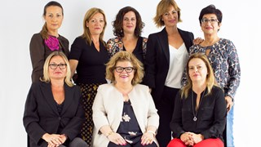
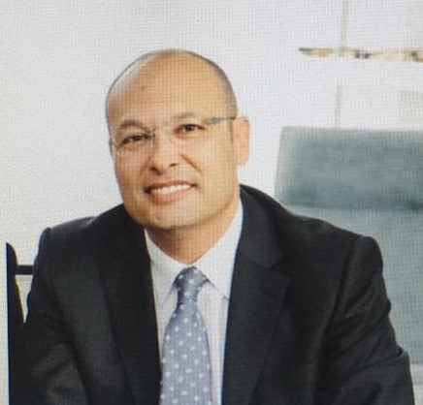
ANIEME is the Spanish National Association of Furniture Manufacturers and Exporters of Spain. We are a non-profit association which has been representing the interests of the furniture industry for more than 40 years.
Established: 1977
With more than 40 years of experience in its field, ANIEME has become the largest community of SMEs in the furnishing sector. The Association fosters creativity and innovation, promoting design as a key tool to strengthening competitiveness in international markets.
Figures: Among 5 biggest producers of furniture in EU, together with Germany, Italy, Poland, France.
ANIEME team
Juan Carlos Muñoz – President of ANIEME

Slide 3
SPANISH INDUSTRY
Number of companies: 6.962
EMPLOYEES: 63.197

Slide 4
PRODUCTION.
FURNITURE RANGE: Home, Contract, Outdoor, Middle to high end range

Slide 5
EXPORT GROWTH
.
2018: +4,3% 2019: +4,7%
MAIN AREAS: 68% in EU (France, Portugal, Uk, Germany), USA, Marocco, México, Middle East

Slide 6
CALENDER JANUARY – JULY 2020
January – February: growth in sales, local and export, big contract market, orders increasing in number and volume.
* “Some of the best start months… compared to previous periods and last year” according to some Ceo industries.
March – April: Total closeness in retail (domestic and EU markets); USA still increasing, time for solidarity
.

Slide 7
May: month of uncertainty, preparation for reopening? Start of healthy crisis in America
Bad expectations: 25-30% decrease of total annual turnover
2 situations in SME: :
Companies1: local market, they face market problems, turnover decrease
Companies 2: global companies, with markets in Europa / Asia/ America: risk comes in different periods so turnover decrease is less; Contract furniture for export ok (middle east/ Asia/ Usa; contract furniture for hotels in Spain: decrease

Slide 8
June- July: opening in Spain and Europe; good sales, expectations improve: -15—25%
Most of the employees are back, most of companies open with full staff
SECOND PART OF THE YEAR: IN GENERAL, companies are stopping big investments and concentrating in adaptation to remote work, to new products and to digital marketing
.

Slide 9
BIG EVENTS CANCELLED – BIG HITS OF THE INDUSTRY
ISALONE MILAN: APRIL- JUNE- AND NOW 2021
MAISON OBJET SEPTEMBER: OFFLINE TO ONLINE EVENT
FURNITURE CHINA SHANGHAI: SEPTEMBER, digital trade show
FERIA HABITAT VALENCIA: 2020 TO 2021; NEW event “AGORA MEETING”
ORGATEC: 2020 TO 2022, part in IMM 2021
TIME FOR VIRTUAL MEETINGS- DIGITALIZATION IN ALL AREAS
.

Slide 10
2º SEMESTER OF 2020
CHALLENGES:
ADAPTATION: TO SURVIVE, financial problems, IT´S NOT A QUESTION OF 2- 3 MONTHS PANDEMIA, IS A MEDIUM TERM PANDEMIA
NEW WAY OF DOING THINGS, NOTHING WILL REMAIN THE SAME:
Sales, production, logistics, consumption, relationships to supplier/customer, communication messages and tools
Digitalization: the time to start or accelerate your transformation, implementation and coordination of areas

Slide 11
Products: ¿new products? ¿new materials? ¿new packaging and delivery conditions?
“home = workspace”
“ home: eating, cooking, doing homework, new cinema, etc….”
Sofas products/ mattresses- beds/ chairs/ tables/ shelves……
New functions of the products: adapt design/ “Social Design”
Marketing: “time of the cocooning, family, of staying long hours at home….”

Slide 12
Opportunity:
B2b: budgets from big fairs to digital marketing campaigns, development of adapted products, support to clients, digital transformation
Consumers: our big competitors (travelling, leisure products…): now to
home, furniture! Take the challenge!

Slide 13
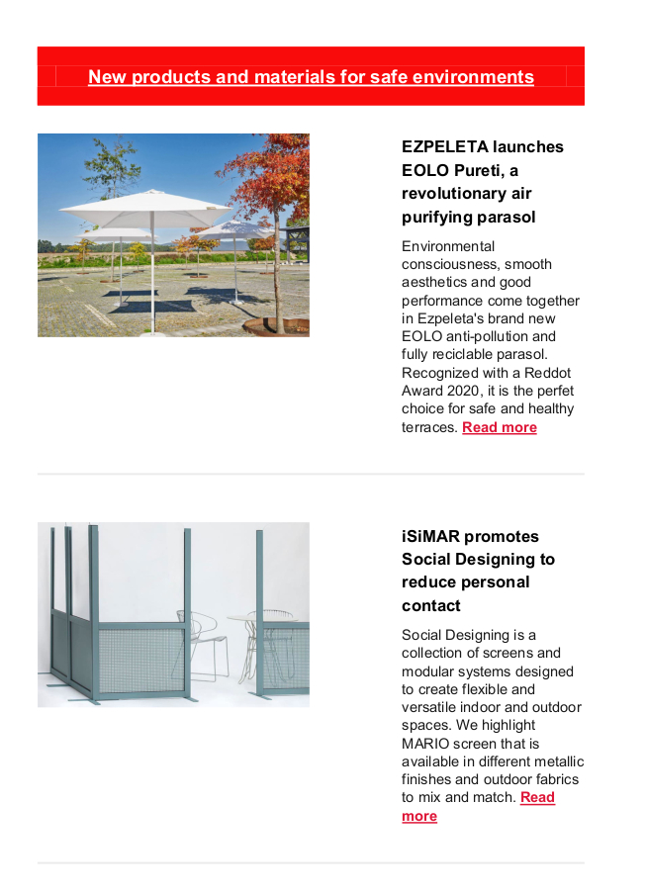

Slide 14
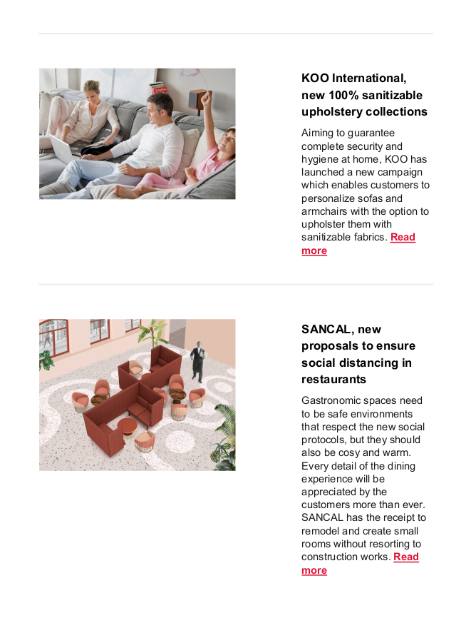

Slide 15
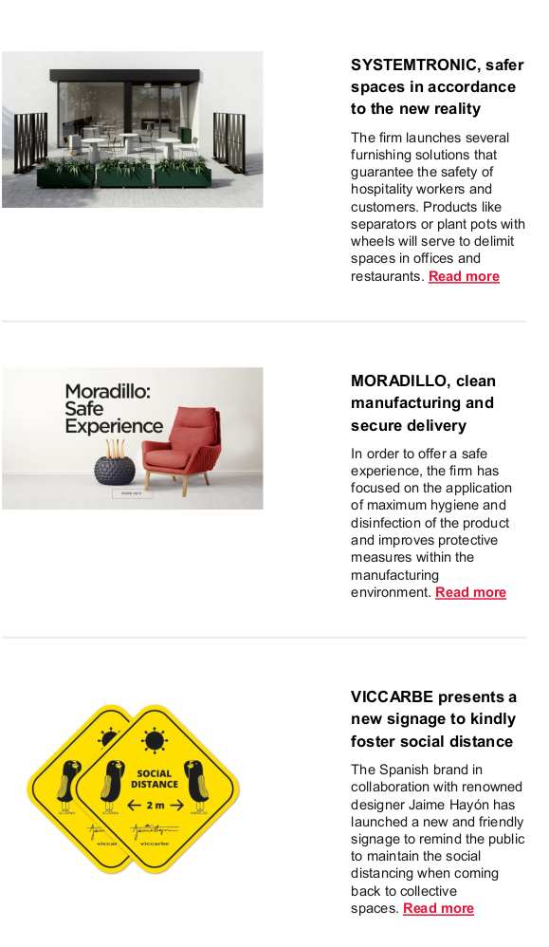

Slide 16
NEAR FUTURE:
UNCERTAINTY:
AMERICA is good market for Spain, situation is different compared to Europe; Mexico, Canada, USA….big growths before pandemia
Europe: hope for stabilization
Spain: controlled health and sanitary system and government supports to industry; coordination of institutions: ANIEME, Technical institutes, Icex, Minestries, Fairs….

Slide 17
Some examples:
Ministry of Science and Innovation: guides for new materials, collaboration with Technical Institutes; subsidies for digital transformation
Ministry of Foreign Trade: support to adapt to virtual meetings b2b, subsidies for digital growth (marketplaces, processes, etc…)
Every month, even every week….situation is changing…
Thanks
Ms. Inmaculada Rey, Deputy Manager ANIEME, Spanish Furniture Association

